Slide 1
An approach to semantic search on technical documentation based on machine learning algorithm for customer request resolution automation
Peter the Great St. Petersburg Polytechnic University
Artem Kovalev, Igor Nikiforov, Pavel Drobintsev
St. Petersburg, Russia, 2020

Slide 2
Field of study
Tech support engineer
Customer
Developer
Emails,
Phone calls,
HelpDesk
Issue Tracking
System
Sustaining phase is one of the most important stages of the software development life cycle
Labor-intensive and ~50% of all software life cycle costs
Sustaining requires automation:
find similar resolved requests
find qualified engineers
find useful documentation

Slide 3
Research goal and tasks
The goal:
Reduce the complexity of the customer requests processing in the Jira issue tracking system by using the Doc2Vec algorithm to search for semantically related documentation pages in local files and wiki resources
Tasks:
Investigate existing approaches in a given research area
Propose an automated approach based on the use of the Doc2Vec algorithm to search for proper documentation
Develop a software tool that implements the proposed approach
Show the effectiveness of the proposed approach and its implementation in a software tool on the relevant data

Slide 4
Related works
Semantic search and similar documents detection are well-established problems in the computer science research
Wei Xing et al. “LDA-based document models for Ad-hoc retrieval”
proposed an LDA-based document model within the language modeling framework and evaluated it on several TREC collections
Jiang Zhuolin et al. “Cross-lingual Information Retrieval with BERT”
explored the use of the BERT in the task of cross-lingual information retrieval
Galke L. et al. “Word embeddings for practical information retrieval”
compared the performance of paragraph vectors and Word Mover’s distance to compute the similarity between the query and the documents
A. Kovalev et al. “Using the Doc2Vec Algorithm to Detect Semantically Similar Jira Issues in the Process of Resolving Customer Requests”
None of the reviewed studies applies the approach based on the Doc2Vec algorithm for semantic search in the software documentation during the maintenance phase
A distinctive feature of our research is the use of the Doc2Vec algorithm to identify semantically related software documentation pages

Slide 5
Automation proposal
Manual approach
Read the title, description, steps to reproduce and comments of the issue
Based on the comments, evaluate the current status of the request
Set the name of the software engineer responsible for the area where the issue occurred
Try to identify a similar, resolved request in the issue tracking system or in the knowledge base
Try to find proper information by keywords for this request in the documentation files
Try to find proper information by keywords for this request in the wiki system
If the solution of the request is known, provide the necessary information to the technical support engineer
If the software engineer needs additional information, then ask the technical support engineer for it in the comments
Proposed semi-automated approach
Read the title, description, steps to reproduce and comments of the issue
Configure the automated tool to get a report for this unresolved request
Run the tool and wait until the end of its processing
Review the generated report, check proposed documentation pages in local files and wiki
Apply recommendations from the report
If the system does not propose any useful pages, then do the manual search

Slide 6
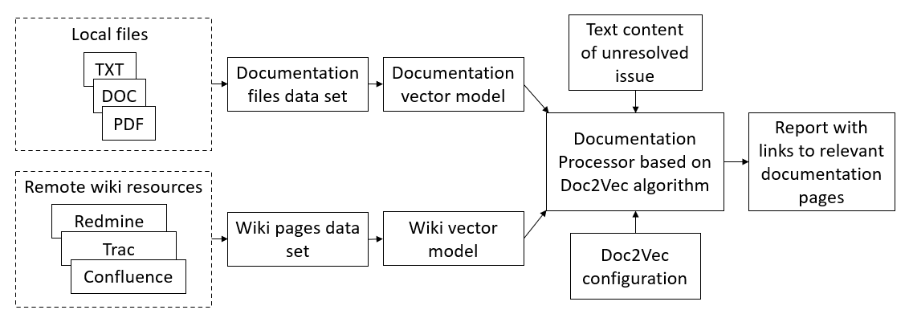
Proposed conceptual schema for analyzing customer requests
The disadvantages of the manual approach could be eliminated using the proposed conceptual schema

Slide 7
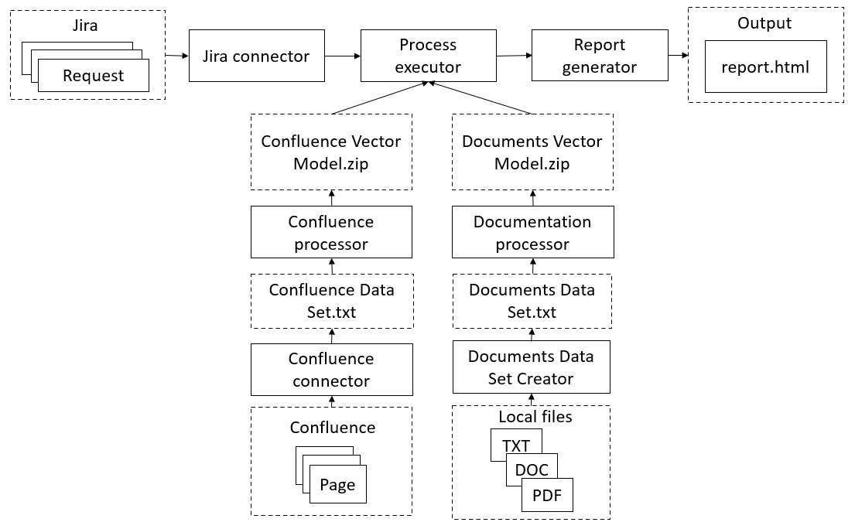
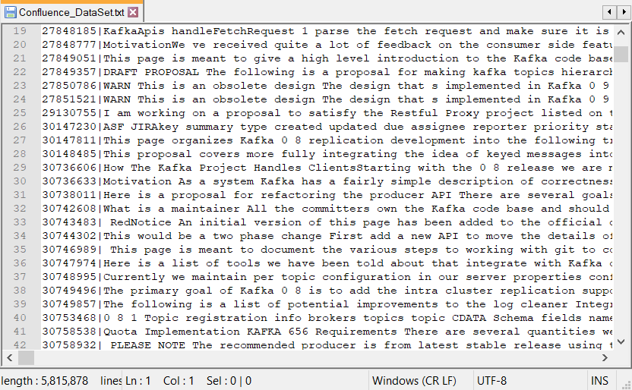
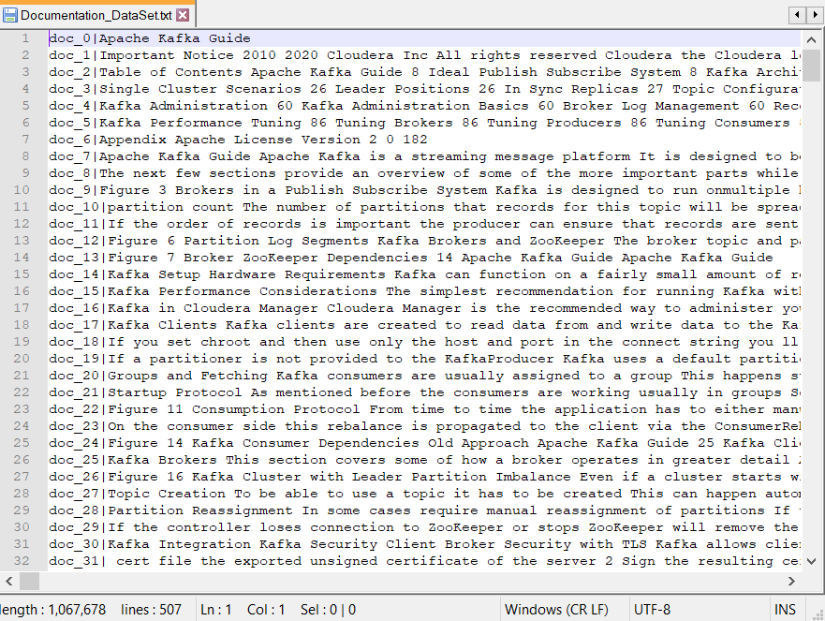
Software architecture
Data Sets
The software allows to generate a user-friendly html report

Slide 8
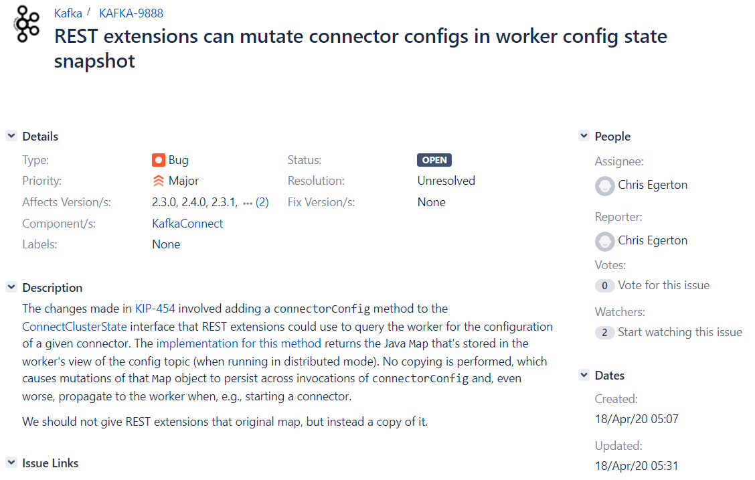
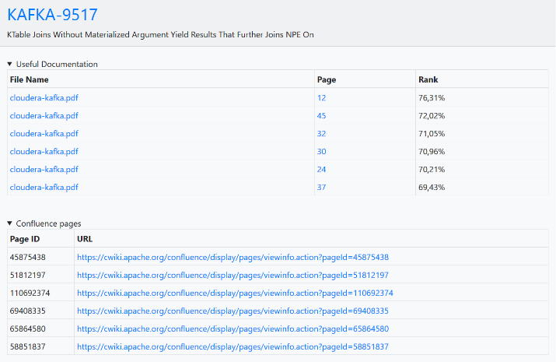
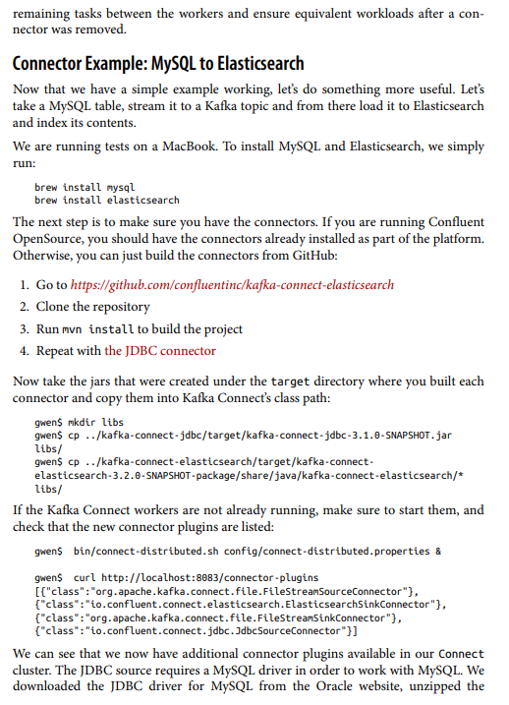
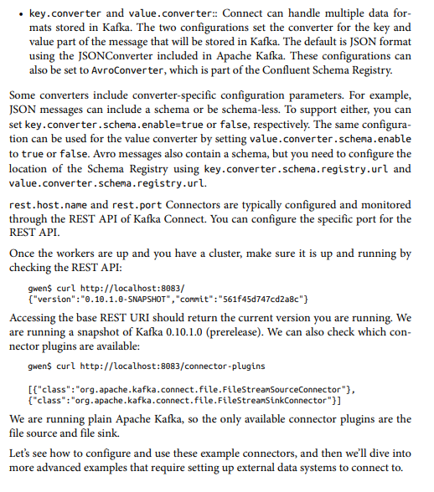
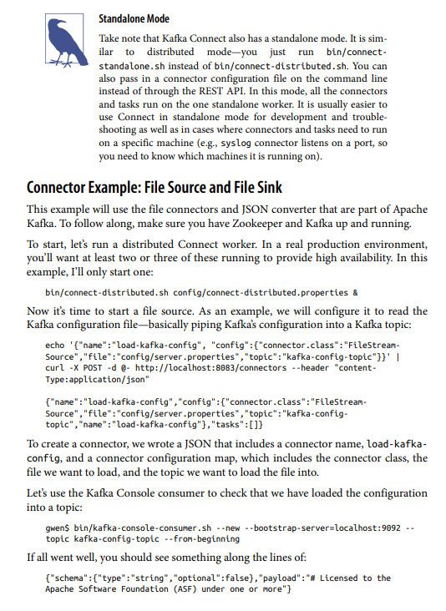
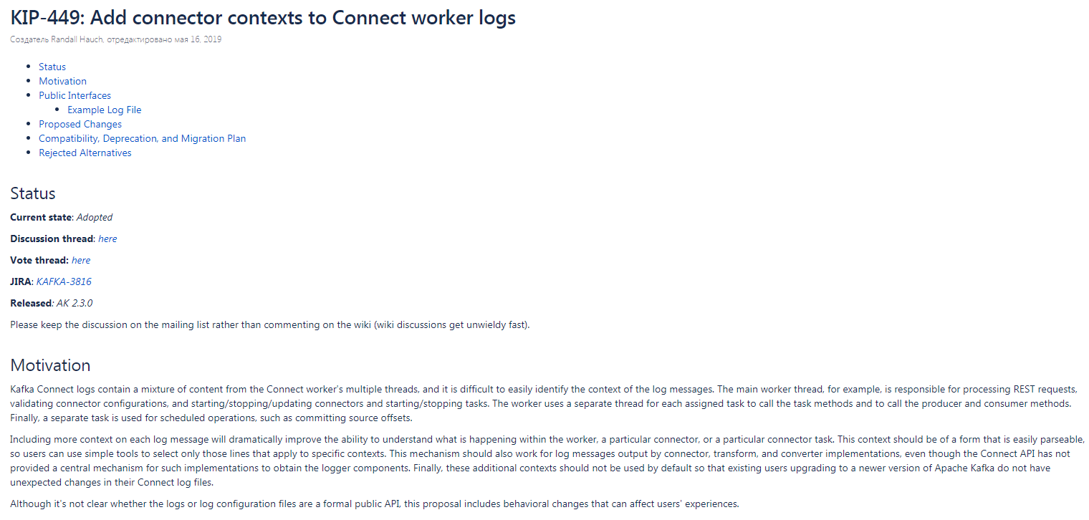
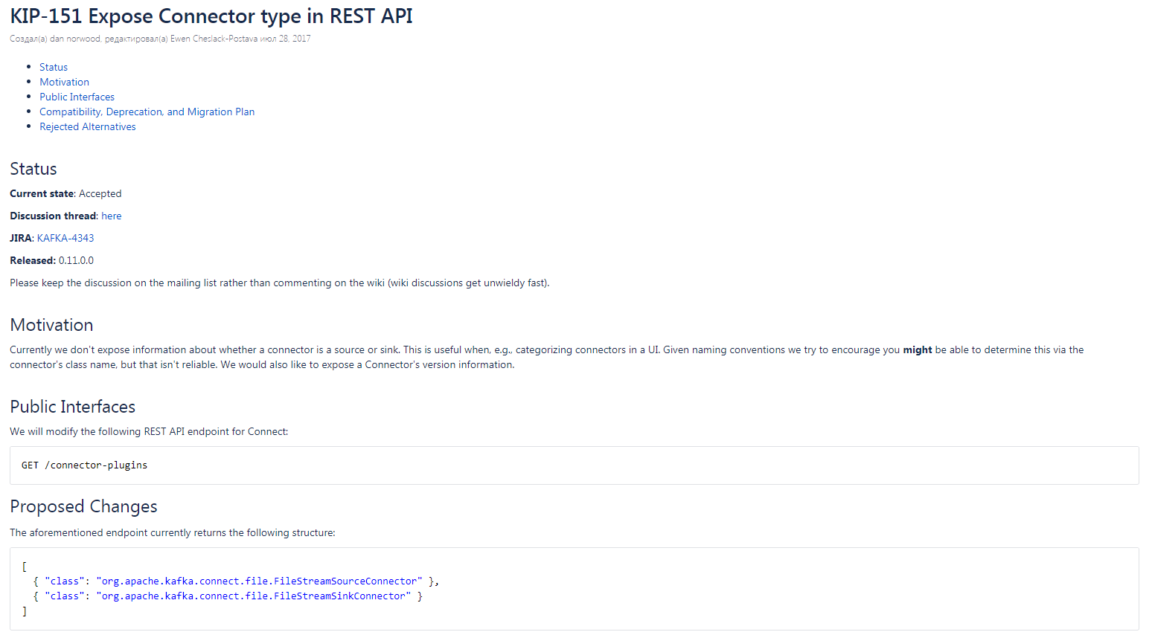
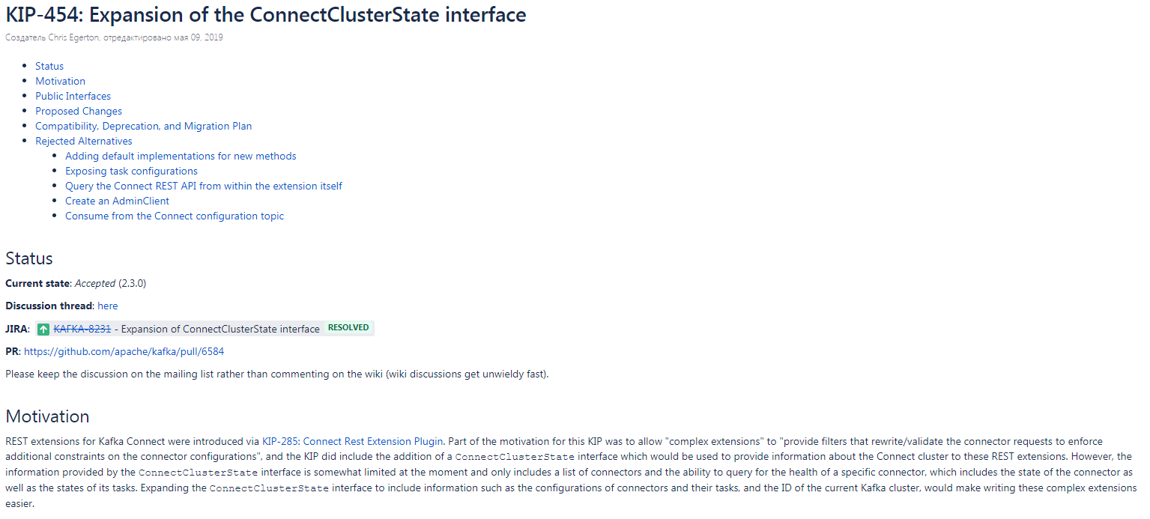
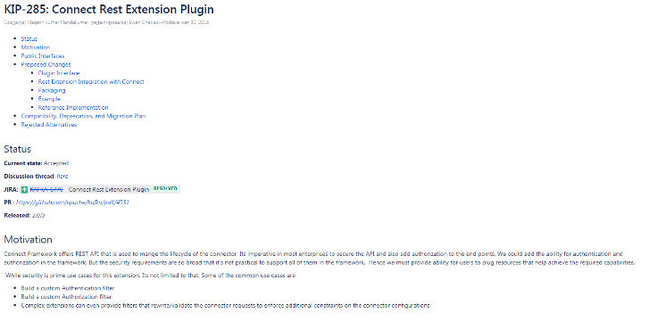
Report
Local files pages
Wiki pages

Slide 9
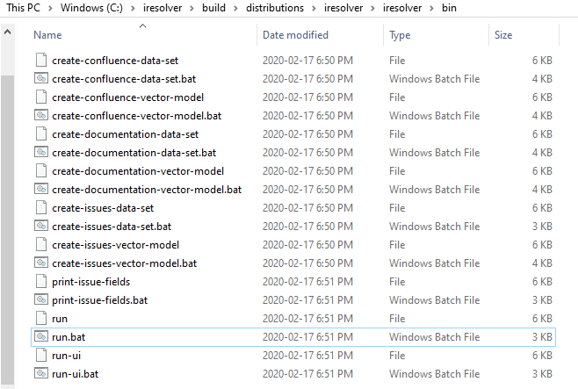
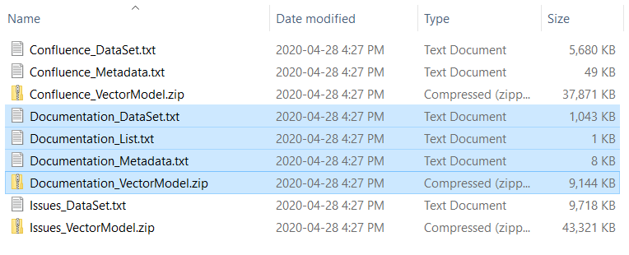
Distribution
built using the Gradle tool
bin folder
data folder

Slide 10
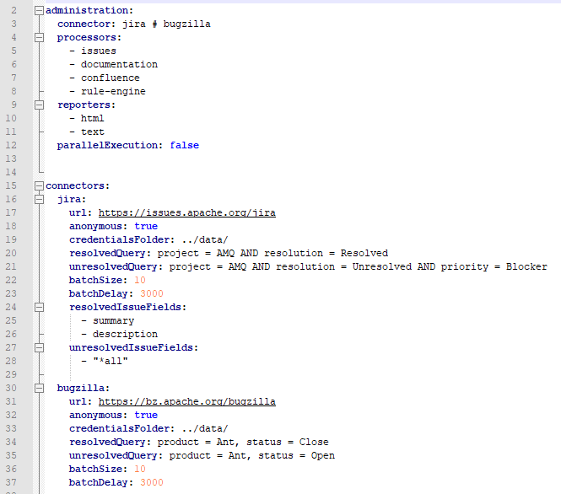
Configuration file
Located in the distribution config folder
Contains parameters for all the parts of the tool:
connectors
processors
reporters
Format
YAML

Slide 11
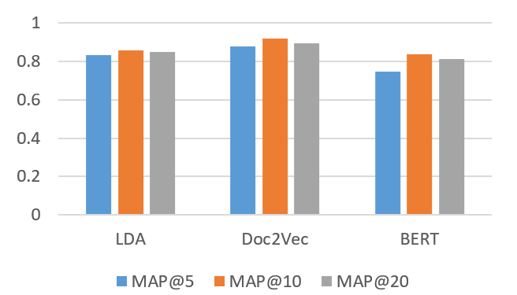
Evaluation of document embeddings
Precision - the fraction of the documentation pages retrieved that are relevant to the user's information need
By computing a precision at every position in the ranked sequence of documents, it is possible to calculate the average precision of the algorithm
Mean average precision (MAP) for a set of queries is simply the mean of all the average precision scores for each query

Slide 12
Experiment
Open-source Apache Kafka project
506 pages from local documentation files and 765 pages from confluence
Creating datasets took 19 minutes, and creating models took 12 minutes
100 requests were obtained from Jira bug-tracking system for testing
The environment:
local workstation, Windows 10 Enterprise x64, Intel Core i7-4810MQ 2.80 GHz and 16 GB RAM
The goal:
compare the average time and the effectiveness of searching the useful documentation for 100 requests using automated and manual approaches
The timer turned on when the engineer started working on a new request and turned off when the engineer found at least one page of the documentation that proved to be useful for solving the request

Slide 13
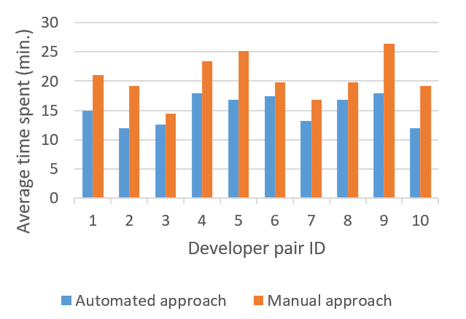
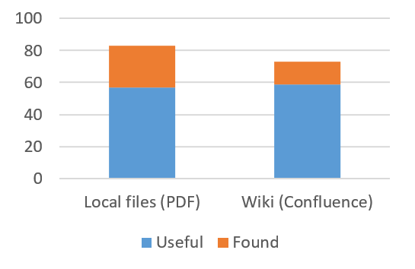
Results
The diagram shows the number of found and the number of useful pages in the documentation for 100 requests
Precision
local files - 69%
wiki pages - 81%
The comparison chart shows that the automated approach takes significantly less time than the manual approach to analyze 100 requests by 10 pairs of engineers
The average time to analyze the documentation for one request using the manual and automated approach is 25,5 and 15,2 minutes, respectively
The decrease in the complexity amounted to 25.9%

Slide 14
Conclusion
Reviewed existing approaches in the field of semantic search in the text documents
Proposed an automated approach to reduce the complexity of customer requests resolving based on the the Doc2Vec machine learning algorithm, which solves the problem of semantic search in the related documentation
Created tool has been successfully tested on the Apache Kafka project
The average time for analyzing documentation has decreased compared to the traditional manual approach
Results show the benefits of using the software tool in the sustaining process
This work is participating in a Dell Technologies Project Competition

Slide 15
Thanks for attention!

