Slide 1
Tracing Network Packets in the Linux Kernel using eBPF
Mark Kovalev
Software Engineering Department
Saint Petersburg State University
SYRCoSE
2020

Slide 2
Problem
Modern networking systems troubleshooting is a complex process
Problems arise even within individual nodes
Exclusion method debugging => high cost of the troubleshooting
Kernel code analysis as a last resort
How a certain traffic is processed by the network stack?
What part of the network stack could posses a source of the malfunction?

Slide 3
Proposed solution
Obtain the information about network packet path in the kernel
Determine, where its processing scenario derivates from intended
Narrow down the scope of the troubleshooting to the certain subsystem
Apply appropriate tools and find the problem cause
Network packet path == call order of the kernel functions that participate in the network packet processing

Slide 4
Goal
Develop the tool that provides information about the network packet path in the Linux kernel using eBPF technology
Easy to use
Performant
Thorough information
Network traffic filter
stdin
Tool
stdout
Path of the packet

Slide 5
eBPF (extended Berkeley Packet Filter)
Extension of the BPF technology
libpcap, tcpdump, seccomp-bpf, xt_bpf for iptables, cls_act for Traffic Control
In-kernel virtual machine with ten 64-bit registers and optimized instruction set
Various attachment points for programs: Traffic Control classifiers, kernel probes, tracepoints, perf events, sockets
Static verification and isolated execution
Programs are loaded into the running kernel
Stable kernel-independent API

Slide 6
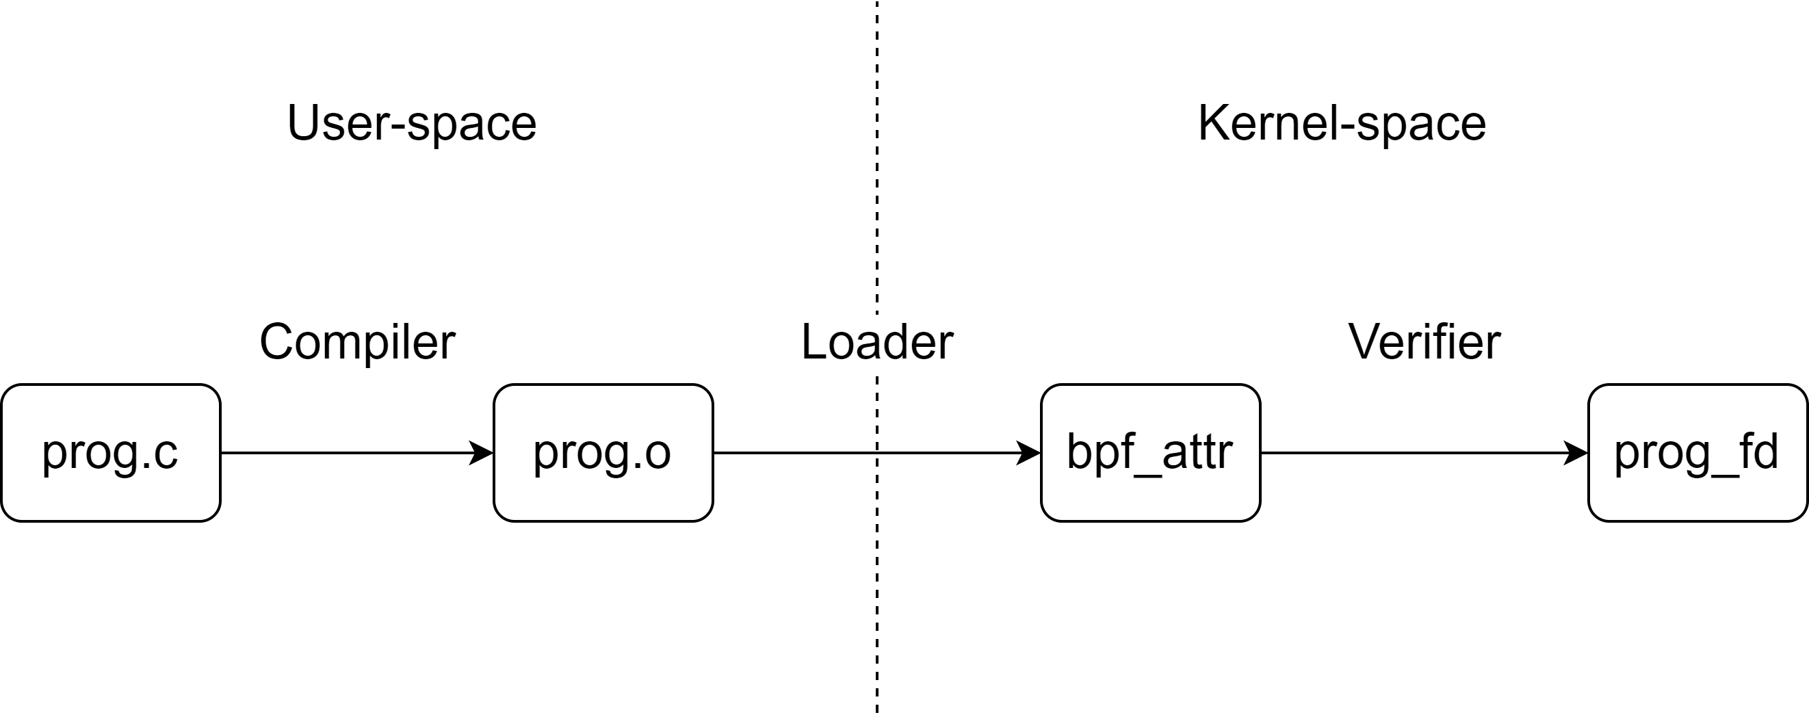
Lifecycle of the eBPF program

Slide 7
Implementation
eBPF objects used:
Traffic Control classifier attachment point (TC program)
Kernel probe attachment point (kprobe program)
eBPF maps
Toolchain:
Restricted C
LLVM+clang
iproute2
libbpf

Slide 8
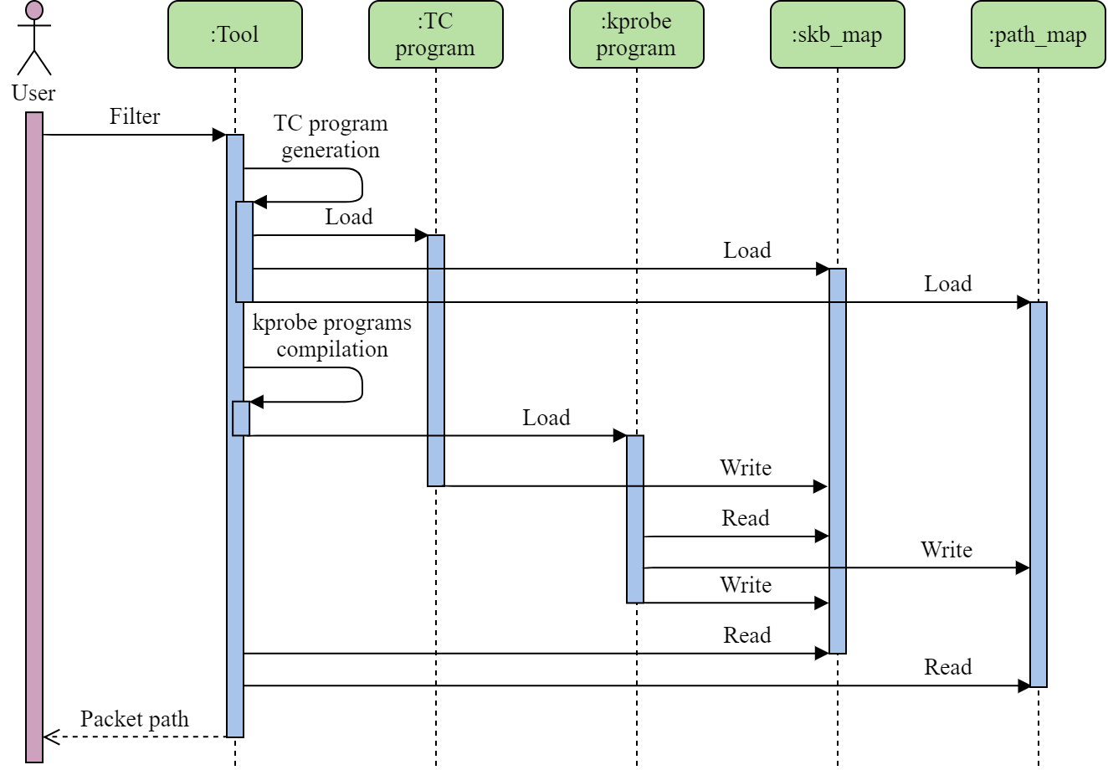
Work algorithm
TC program is generated from filter
Kprobe programs are compiled and identified from kp_func.list file
Pointer to the packet is stored in skb_map
Timestamps are stored in path_map
skb_map filled with ones is a signal to stop observation
Path is the sorted list of the timestamps from path_map

Slide 9
Example
[root@rch tracing]# cat trace_pipe
<idle>-0 [004] ..s1 39090.808233: 0: --------PACKET MATCH--------
<idle>-0 [004] ..s1 39090.808255: 0: __netif_receive_skb_core: 39090666105243
<idle>-0 [004] ..s4 39090.808262: 0: nf_ip_checksum: 39090666113535
<idle>-0 [004] ..s4 39090.808264: 0: nf_ct_get_tuple: 39090666115546
<idle>-0 [004] ..s4 39090.808270: 0: ipt_do_table: 39090666121667
<idle>-0 [004] ..s4 39090.808279: 0: ip_local_deliver: 39090666130170
<idle>-0 [004] ..s4 39090.808280: 0: ipt_do_table: 39090666130862
<idle>-0 [004] ..s4 39090.808281: 0: ipt_do_table: 39090666132058
<idle>-0 [004] ..s4 39090.808289: 0: nf_confirm: 39090666139780
<idle>-0 [004] ..s4 39090.808294: 0: icmp_rcv: 39090666144997
<idle>-0 [004] ..s4 39090.808345: 0: consume_skb: 39090666195327

Slide 10
Implementation details
Packet filtration happens only once
TC program filters packet
kprobe programs compare pointers
Programs have different contexts
__sk_buff for TC
pt_regs for kprobe
BCC (BPF Compiler Collection) is not used
full implementation control
low footprint
List of probed functions could be easily changed
portability
ability to add custom functions

Slide 11
Similar functionality
VMware Traceflow
Part of the VMware NSX Data Center for vSphere platform
High-level observation of the whole network
ftrace
Can trace packet path if traffic is isolated
tcpdrop
Part of the BCC
Shows stack trace of the functions that led to the packet drop

Slide 12
Current state and future work
The TC program is static and can trace incoming ICMP, TCP, or UDP.
The kprobe programs are compiled manually.
Packet path is observed via /sys/kernel/debug/tracing/trace_pipe file.
To reach an MVP state for the tool, the following things are to be implemented:
TC program generation.
Kprobe programs compilation automatization.
Bash-based tool that links all components and provides user interface.

Slide 13
Points of consideration
Amount of the kprobe programs.
Troubleshooting comparison with and without the tool.
Use of the tracepoints as a more stable kernel API.

Slide 14
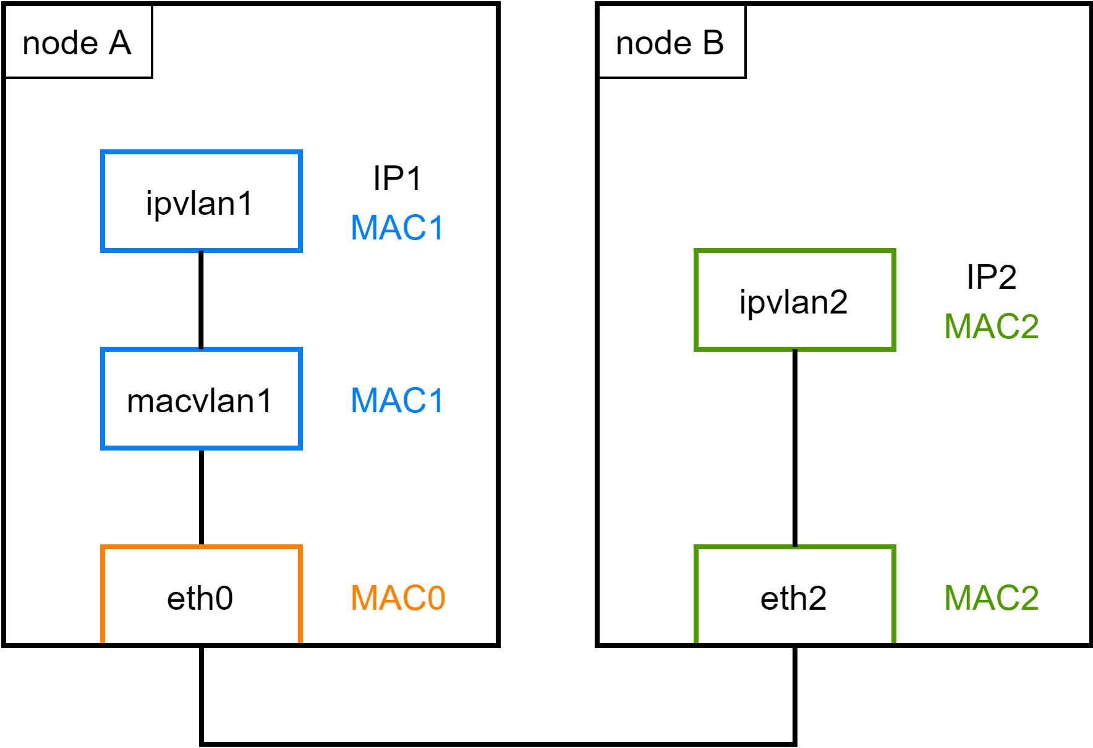

Slide 15
__section("main") int skb_filter(struct __sk_buff *skb) { uint32_t skb_key = 0; void **skb_val = map_lookup_elem(&skb_map, &skb_key); if (skb_val == NULL) return TC_ACT_OK; if (*skb_val != 0) return TC_ACT_OK; void *data = (void *)(long)skb->data; void *data_end = (void *)(long)skb->data_end; struct ethhdr *eth = data; struct iphdr *iph = data + sizeof(*eth); if (data + sizeof(*eth) + sizeof(*iph) > data_end) return TC_ACT_OK; if (eth->h_proto != htons(ETH_P_IP)) return TC_ACT_OK; if (iph->protocol != IPPROTO_ICMP) return TC_ACT_OK; if (iph->saddr != htonl(IP_SRC)) return TC_ACT_OK; *skb_val = (void *)skb; return TC_ACT_OK; }

Slide 16
__section(KP_SEC) int skb_check(struct pt_regs *ctx) { uint32_t skb_key = 0; void **skb_val = map_lookup_elem(&skb_map, &skb_key); if (skb_val == NULL) return 0; if (*skb_val == 0 || *skb_val == SKB_FIN) return 0; void *skb = (void *) PT_REGS_PARM1(ctx); if (skb != *skb_val) return 0; uint32_t path_key = KP_NUM; uint64_t path_value = ktime_get_ns(); err = map_update_elem(&path_map, &path_key, &path_value, BPF_ANY); if (err < 0) return 0; #if KP_FIN == 1 *skb_val = SKB_FIN; #endif return 0; }

