Slide 1
Comparative Analysis of Homomorphic Encryption Algorithms Based on Learning with Errors
North-Caucasus Federal University (NCFU)
Mikhail Babenko NCFU, Stavropol, Russia mgbabenko@ncfu.ru | Elena Golimblevskaia NCFU, Stavropol, Russia elena.golimblevskaya@gmail.com | Egor Shiryaev NCFU, Stavropol, Russia ea_or@list.ru
SYRCoSE Software Engineering Colloquium
May 28-29 2020

Slide 2
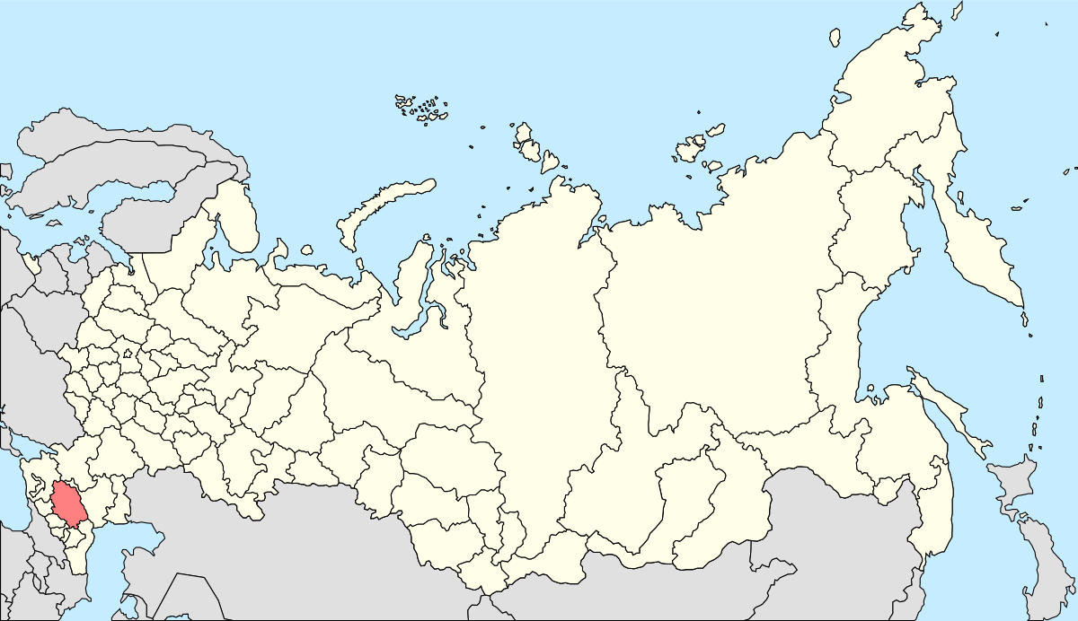
Where we are from Stavropol Region on the map of Russia

Slide 3
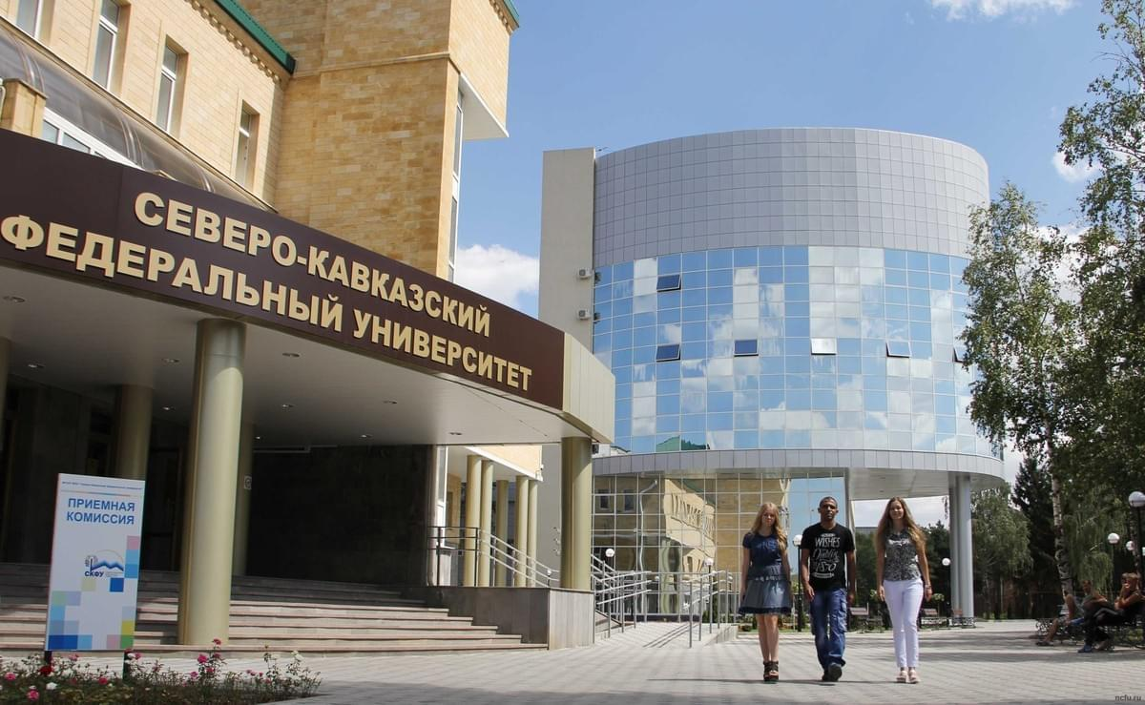
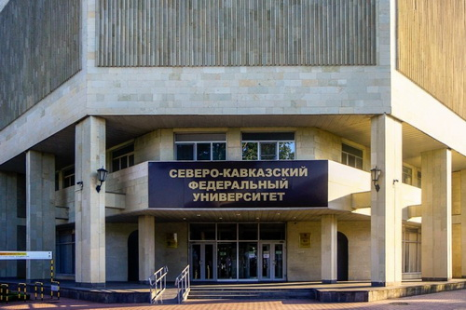
North-Caucasus Federal University

Slide 4
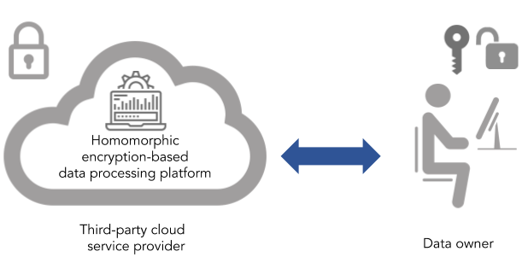
Homomorphic Encryption
Homomorphic encryption is a form of encryption that allows computation on ciphertexts, generating an encrypted result which, when decrypted, matches the result of the operations as if they had been performed on the plaintext.

Slide 5
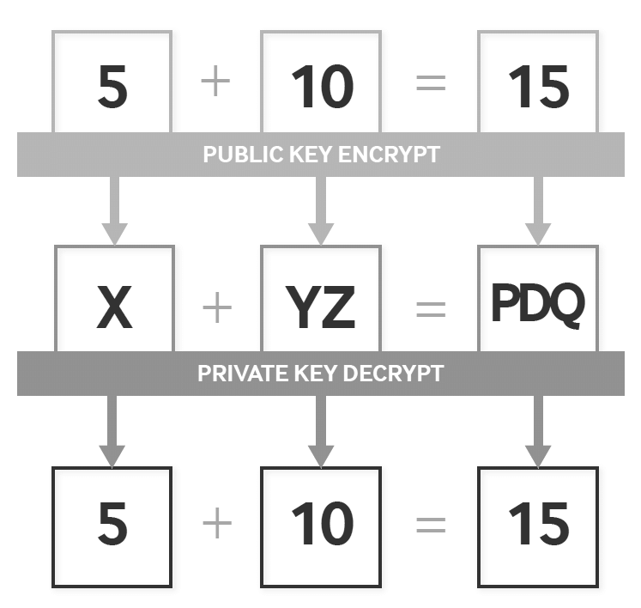
Fully Homomorphic Encryption

Slide 6
Application of Fully Homomorphic Encryption
Securing Data Stored in the Cloud;
Enabling Data Analytics in Regulated Industries;
Improving Election Security and Transparency.

Slide 7
Residue Number System (RNS)
RNS is a non-weighted number system based on modular arithmetic.
The representation of a number in RNS is based on a comparison of two integers modulo and the Chinese Remainder Theorem (CRT).

Slide 8
Advantages of Residue Number System (RNS)
Split integers into multiple smaller independent components.
Computation in parallel.
Faster computation.
Lower power consumption.

Slide 9
Homomorphic Encryption Schemes
To conduct research on HE schemes, we selected the LattiGo lattice-based cryptography library, written in the Golang language. This library is an open source project on github.com, it contains a set of functions that implement homomorphic encryption schemes.

Slide 10
Common Properties of HE Schemes
Parameters of HE schemes:
$N=2^{\log{N}}$ – the ring dimension;
$Q$ – ciphertext moduli;
$σ$ – variance.
The plaintext space and the ciphertext space share the same domain, which we denote as $ℋ$:
$$ℋ=ℤ_{Q}\left[X\right]/(X^{N}+1)$$
where N is a power of two.

Slide 11
CKKS | BFV
CKKS is a homomorphic encryption scheme for approximate number arithmetic, suggested by Cheon, Kim, Kim, and Song. | BFV is a Fan-Vercauteren version of scale-invariant Brakerski HE scheme.
Independent parameters
$Scale$: plaintext scale. | $P$: expanded ciphertext moduli. $t$: plaintext moduli.

Slide 12
Analysis of HE Schemes Function Performance
Measurements are carried out for
different dimensions of the encrypted vector (128-2048 numbers);
different encryption parameters:
Benchmarking is performed for functions such as
Encoding;
Decoding,
Encryption;
Decryption;
Addition;
Multiplication;
Relinearization;
KeySwitching.
ID | $$\log_{2}{N}$$ | $$\log_{2}{Q}$$ | $$σ$$
1 | 12 | 109 | 3.2
2 | 13 | 218 | 3.2
3 | 14 | 438 | 3.2
4 | 15 | 881 | 3.2

Slide 13
Analysis of Encoding Function

Slide 14
Analysis of Decoding Function

Slide 15
Analysis of Encryption Function
Encryption with Secret Key
Encryption with Public Key

Slide 16
Analysis of Decryption Function

Slide 17
Analysis of Addition Function

Slide 18
Analysis of Multiplication Function
Multiplication by scalar
Multiplication by ciphertext

Slide 19
Analysis of Relinearization Function

Slide 20
Analysis of KeySwitching Function

Slide 21
Signal to Noise Ratio (SNR)
SNR of Plaintext to Vector
SNR of Ciphertext to Plaintext

Slide 22
Conclusion
We investigated two schemes of CKKS and BFV homomorphic data encryption from the point of view of technical characteristics.
A comparison of the two schemes shows that there is no one-size-fits-all approach that can be used as a universal solution.
Further we plan to investigate a question of realization of matrix operations with use of various homomorphic encryption schemes.

Slide 23
North-Caucasus Federal University (NCFU)
Thank you for attention.
SYRCoSE Software Engineering Colloquium
May 28-29 2020

