Slide 1
Development of automated computer vision methods for cell counting and endometrial gland detection for medical images processing
with assistance of SPSPMU
2018

Slide 2
Relevance
The processing of medical images is an extremely important issue for biology and medicine.
Pathomorphologists have to process hundreds of images of preparations per day. Their work can be automated due to computer analysis.
The use of automated applications for counting nuclei and determining their markers significantly increases the images processing speed and reliability.
The modern software, designed for morphometry, has several limitations.
Development of automated computer vision methods for medical images processing

Slide 3
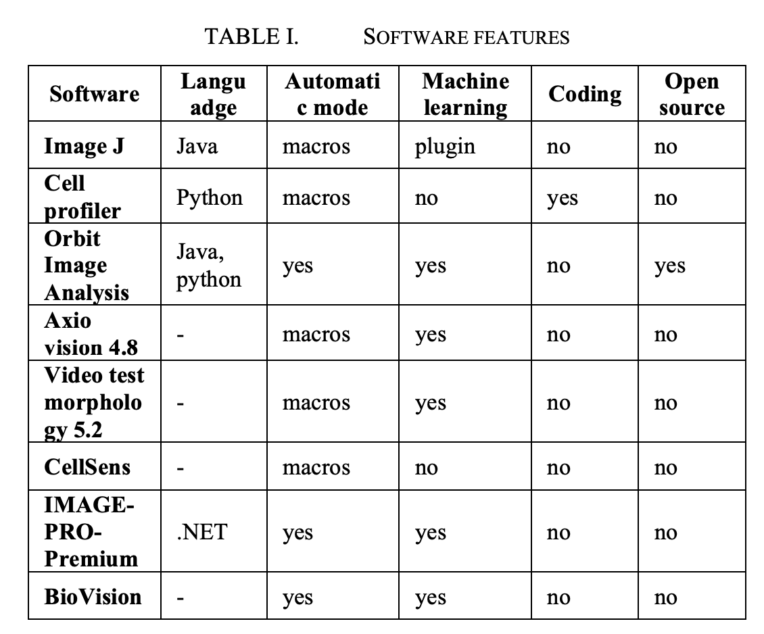
Modern morphometry software
What
limitations?
Development of automated computer vision methods for medical images processing

Slide 4
Software limitations
Most of the free automatic and semi-automatic programs are incomplete and require bioinformatics in the team.
Semi-automatic programs in most cases require input parameters, such as parameters of the microscope, the type of tissue and the lighting of a particular picture.
Part of the programs require to write macros, which is hard for pathomophologists.
The most convenient and user-friendly programs have a high cost.
Development of automated computer vision methods for medical images processing

Slide 5
Formulation of the problem
The aim of the work is the research and development of the following algorithms:
The cell nuclei number estimation with and without researched marker expression on light microscopy image preparations;
The cell nuclei number estimation with and without researched marker expression on confocal microscopy image preparations;
Highlighting the internal and external glands borders in the confocal microscopy image preparations.
Development of automated computer vision methods for medical images processing

Slide 6
The image datasets
Confocal images of breast adenocarcinomas and dissociated endometrial cultures was provided by the Institute of Obstetrics, Gynecology and Reproductology Ott.
The shooting of individual classes of images was carried out with a fixed scale of the microscope.
Image preparations of various types of tissues with different lighting conditions and marker colors were collected and labelled.
Development of automated computer vision methods for medical images processing

Slide 7
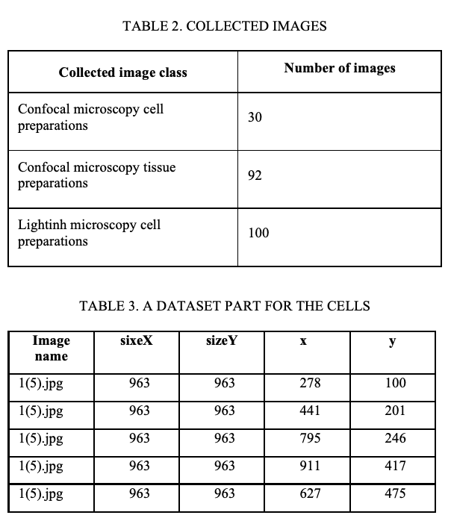
The image datasets
For each image from the database, a list of nuclei is compiled indicating the coordinates of their centers in the image space, as well as the type of marker.
Development of automated computer vision methods for medical images processing

Slide 8
Requirements
For all algorithms, the following requirements are established:
Work without an operator;
Resistance to changes in the brightness of the preparation;
Resistance to various colors of markers;
Image scale is an input parameter of the algorithms (it is planned to detect it by the size of the scale bar)
Development of automated computer vision methods for medical images processing

Slide 9
Suggested algorithms
There are three algorithms that were developed
Counting the number of nuclei on confocal microscopy images;
Internal contours glands detection in confocal microscopy images;
Counting the number of nuclei in light microscopy images.
The algorithms were developed in the PyCharm environment in Python 3.7 using the OpenCV-python 4.0.0.21 library.
The source code of developed algorithms and the dataset is available at https://github.com/densvr/biomedicine-diagnostic
Development of automated computer vision methods for medical images processing

Slide 10
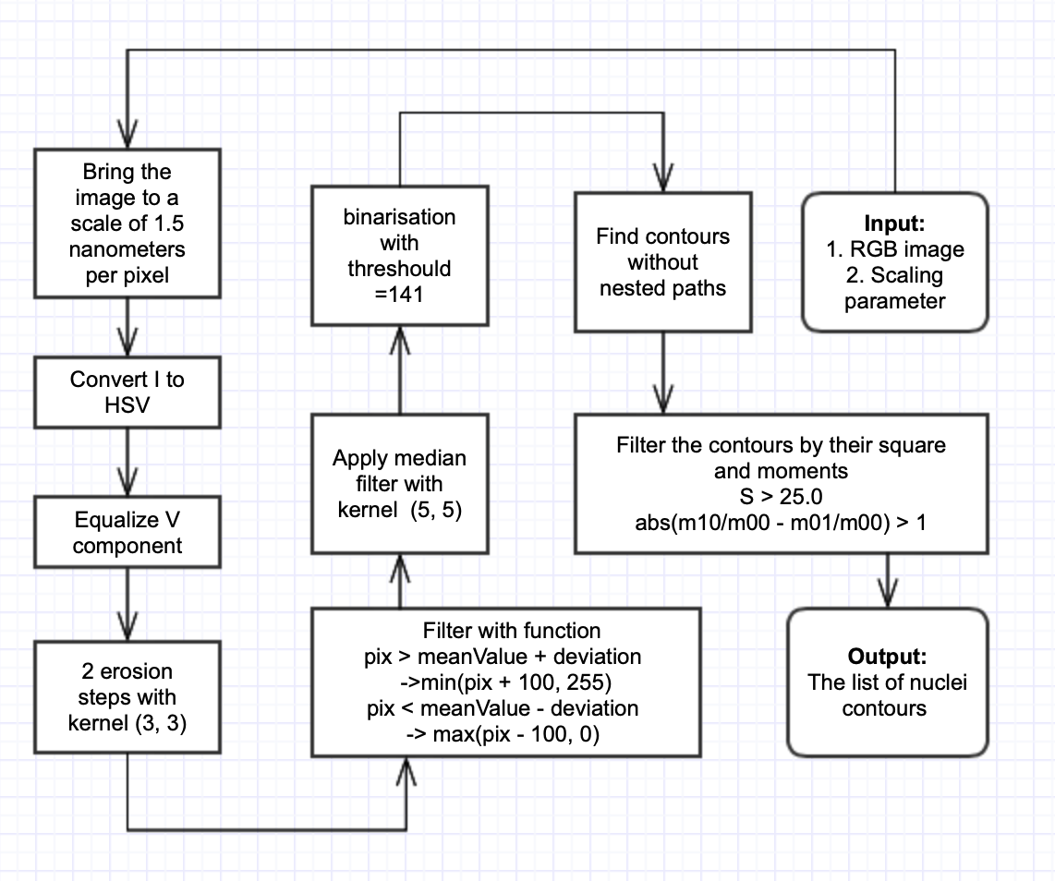
1. Counting the number of nuclei in confocal microscopy images
Development of automated computer vision methods for medical images processing

Slide 11
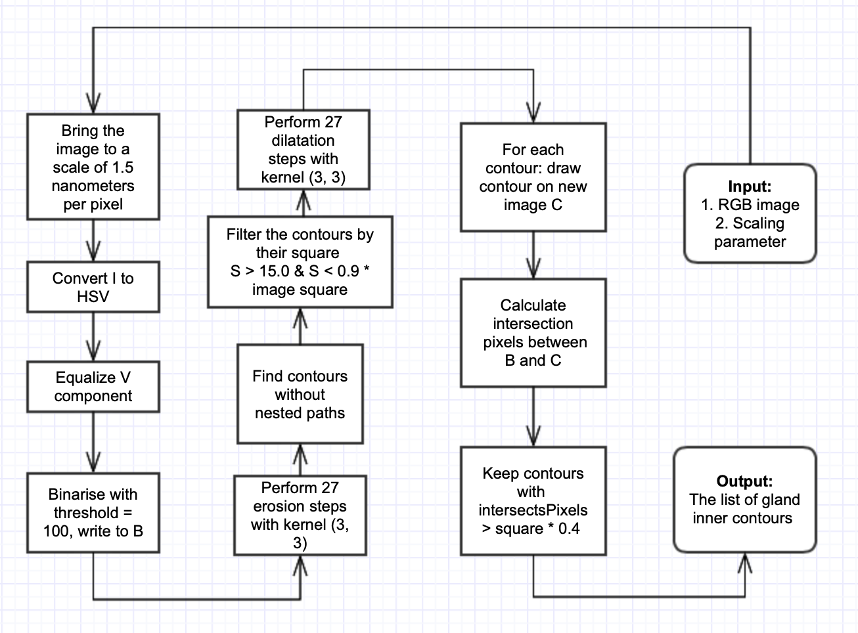
2. Internal contours glands detection in confocal microscopy images
Development of automated computer vision methods for medical images processing

Slide 12
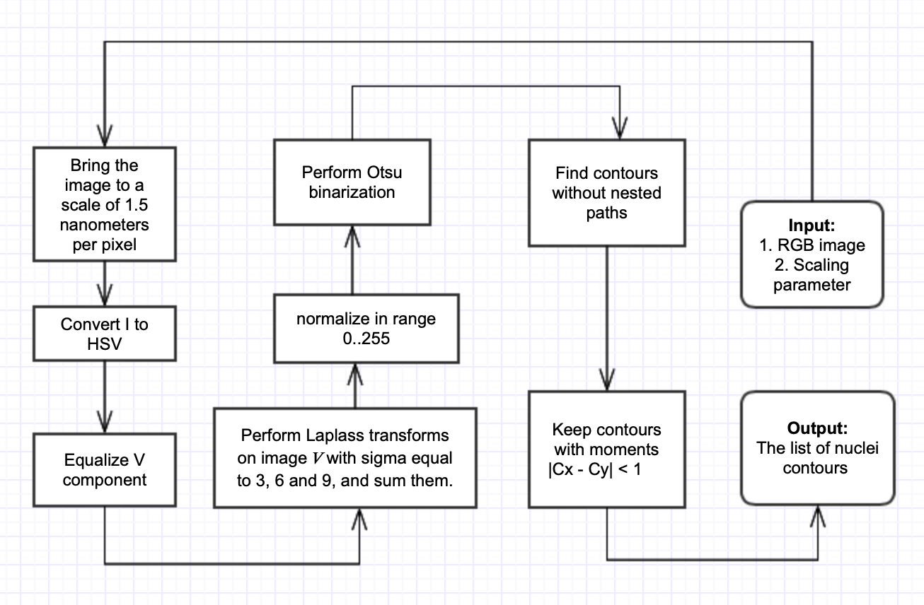
3. Counting the number of nuclei in light microscopy images
Development of automated computer vision methods for medical images processing

Slide 13
Results of counting the number of nuclei in confocal microscopy images
The percent of successful recognition in the researched images was 84% and calculated by formula (2) as average for each image I,
Where:
N_{ԁ} - were the number of detected nuclei on image I;
N_{Ɩ} – the number of labeled nuclei on image I.
Development of automated computer vision methods for medical images processing

Slide 14
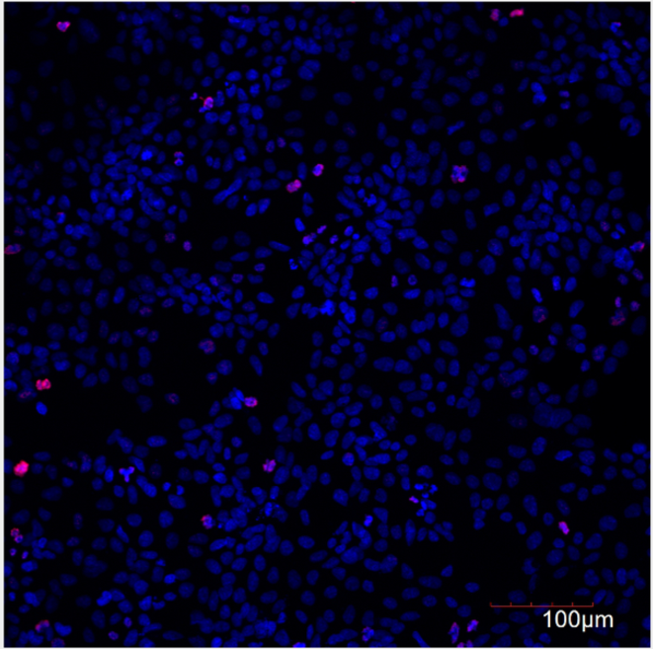
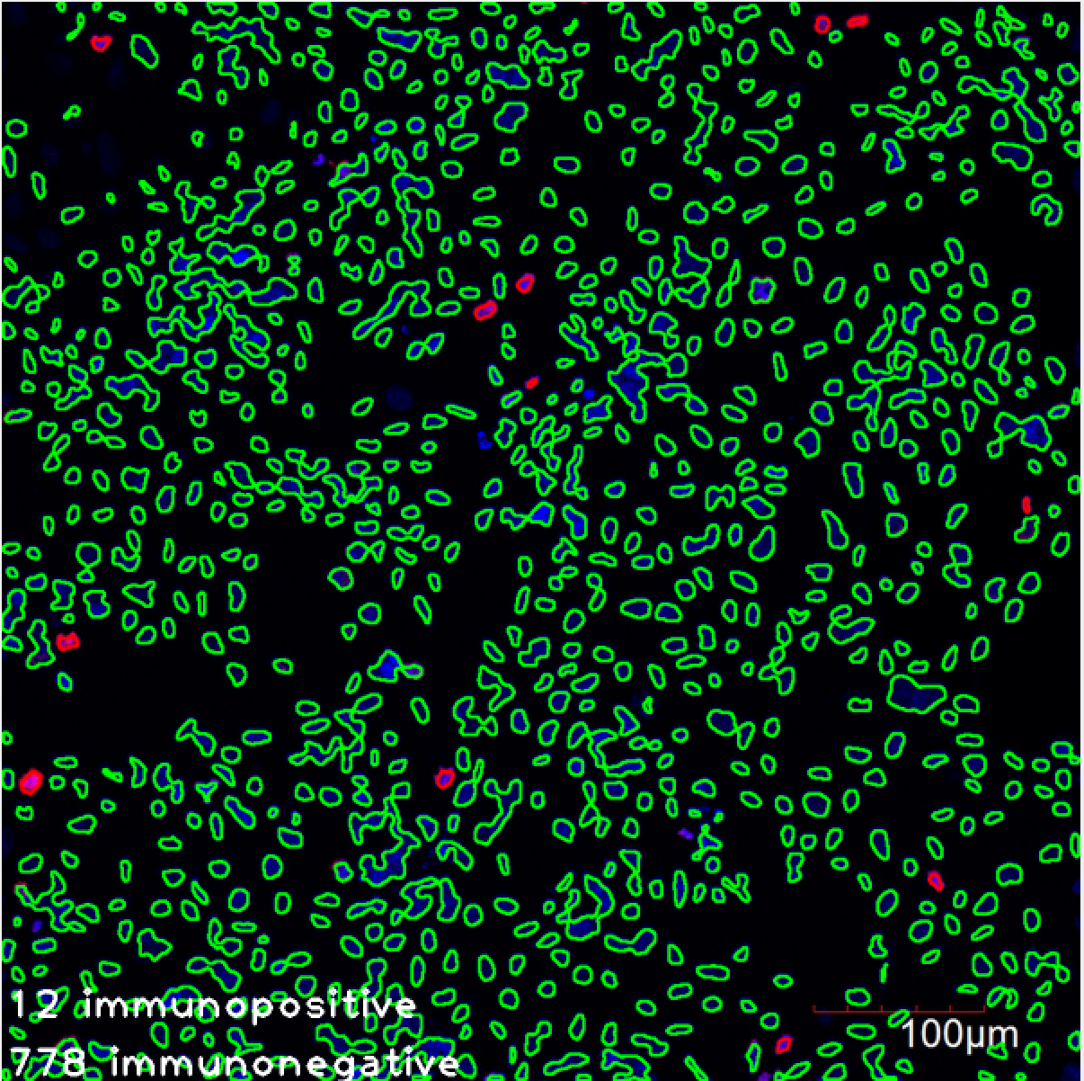
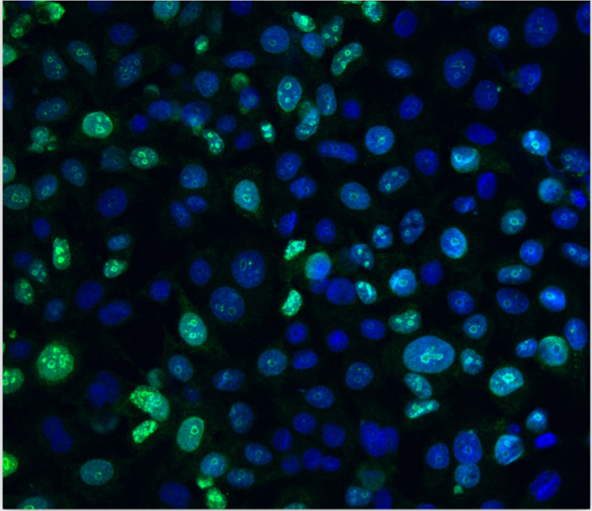
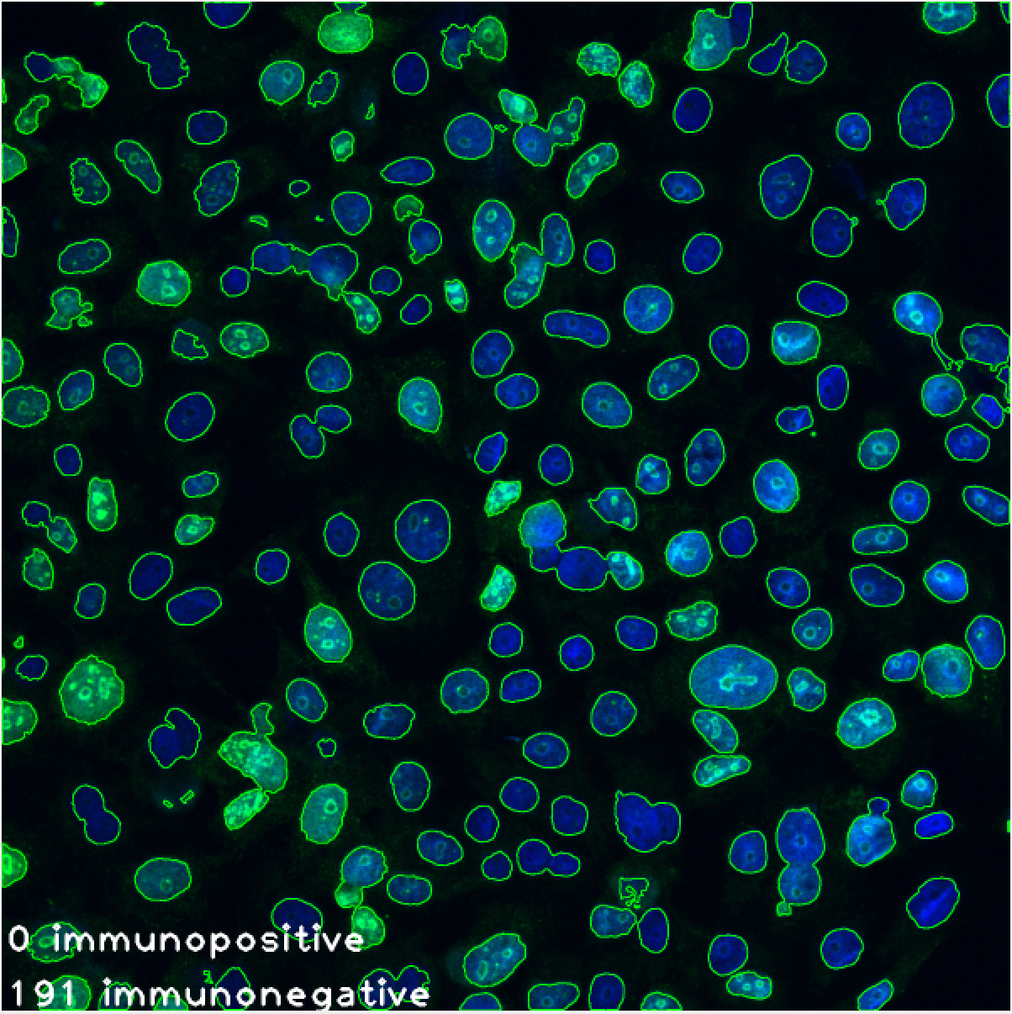
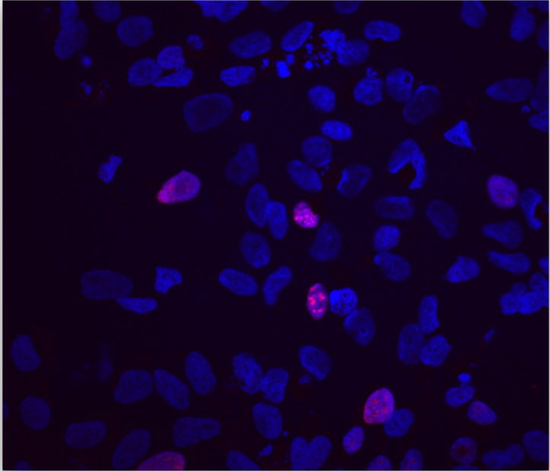
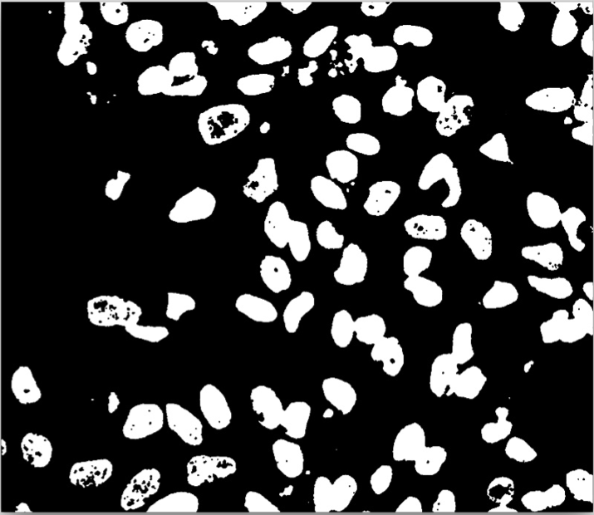
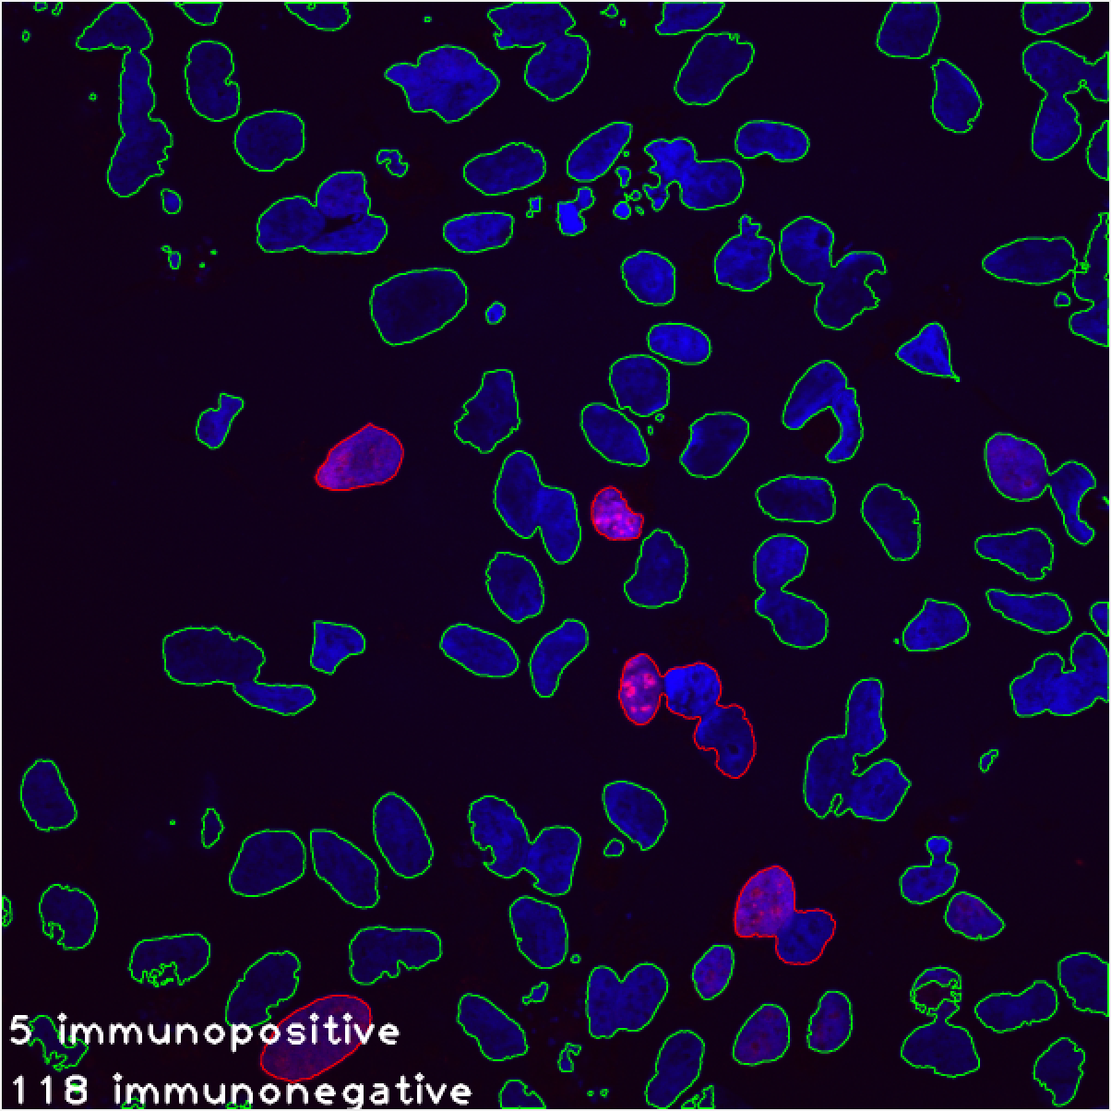
Results of counting the number of nuclei in confocal microscopy images (2)
1.
2.
3.
Development of automated computer vision methods for medical images processing

Slide 15
Results of internal contours glands detection in confocal microscopy images
The percent of successful recognition in the researched images was 70% and calculated by formula (3) as average for each image I,
Where:
A_{ԁ} - the intersection area of the marked and detected contours on image I;
A_{Ɩ} – total area of the marked out contours on image I.
Development of automated computer vision methods for medical images processing

Slide 16
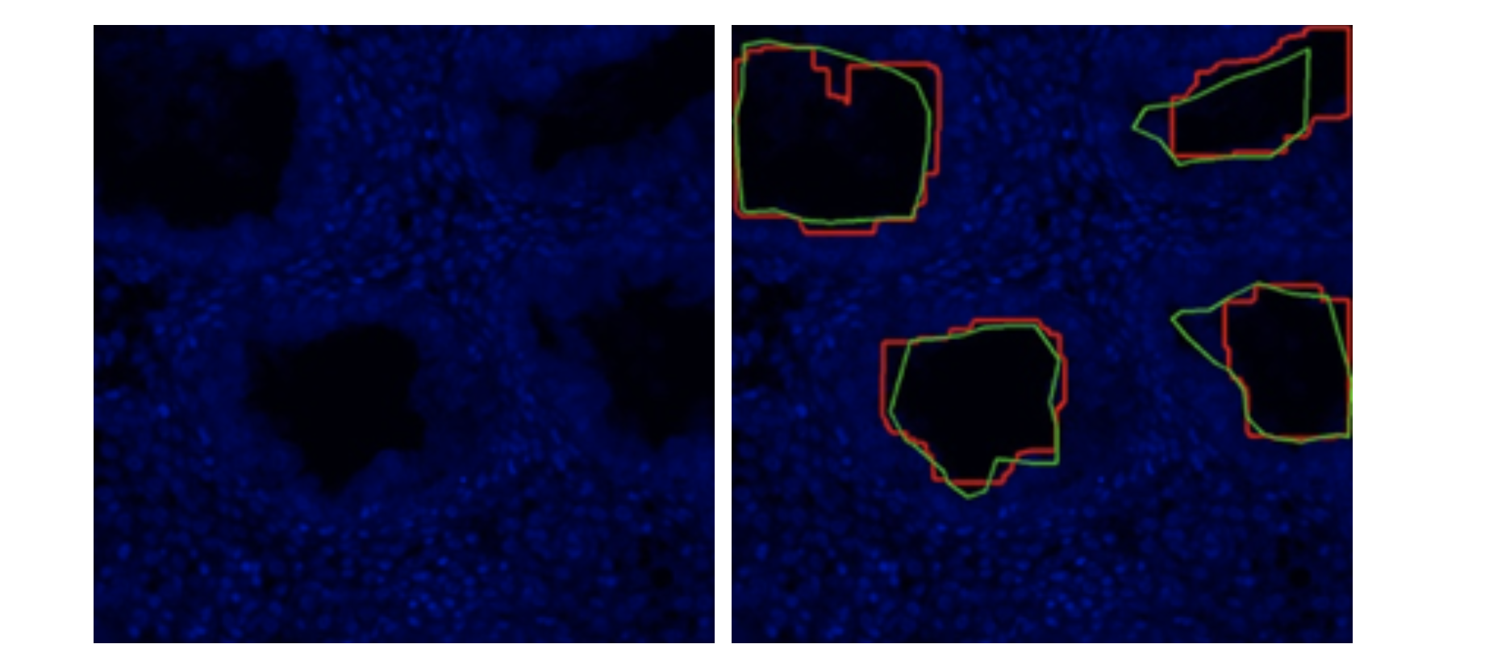
Results of internal contours glands detection in confocal microscopy images (2)
Initial image – on the left,
Image with highlighted glands - on the right, where
labelled contours highlighted green;
Detected contours highlighted red.
Development of automated computer vision methods for medical images processing

Slide 17
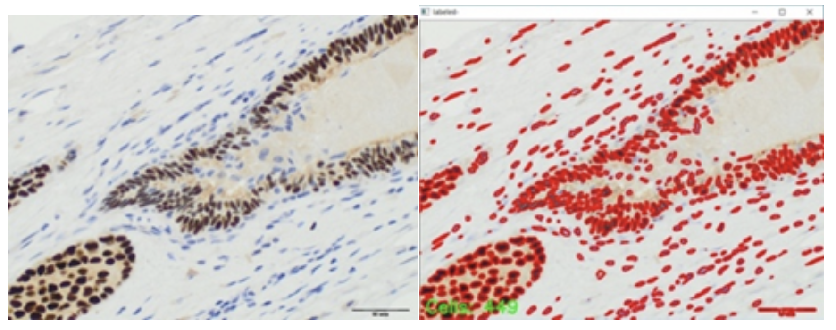
Results of counting the number of nuclei in light microscopy images
The percent of successful recognition in the researched images was 90% and calculated by formula (2) like for confocal case.
Initial image (left), image with selected nuclei (right)
Development of automated computer vision methods for medical images processing

Slide 18
Results of counting the number of nuclei in light microscopy images (2)
The percent of successful recognition in the researched images was 70% and calculated by formula (3) as average for each image I,
Where:
A_{ԁ} - the intersection area of the marked and detected contours on image I;
A_{Ɩ} – total area of the marked out contours on image I.
Development of automated computer vision methods for medical images processing

Slide 19
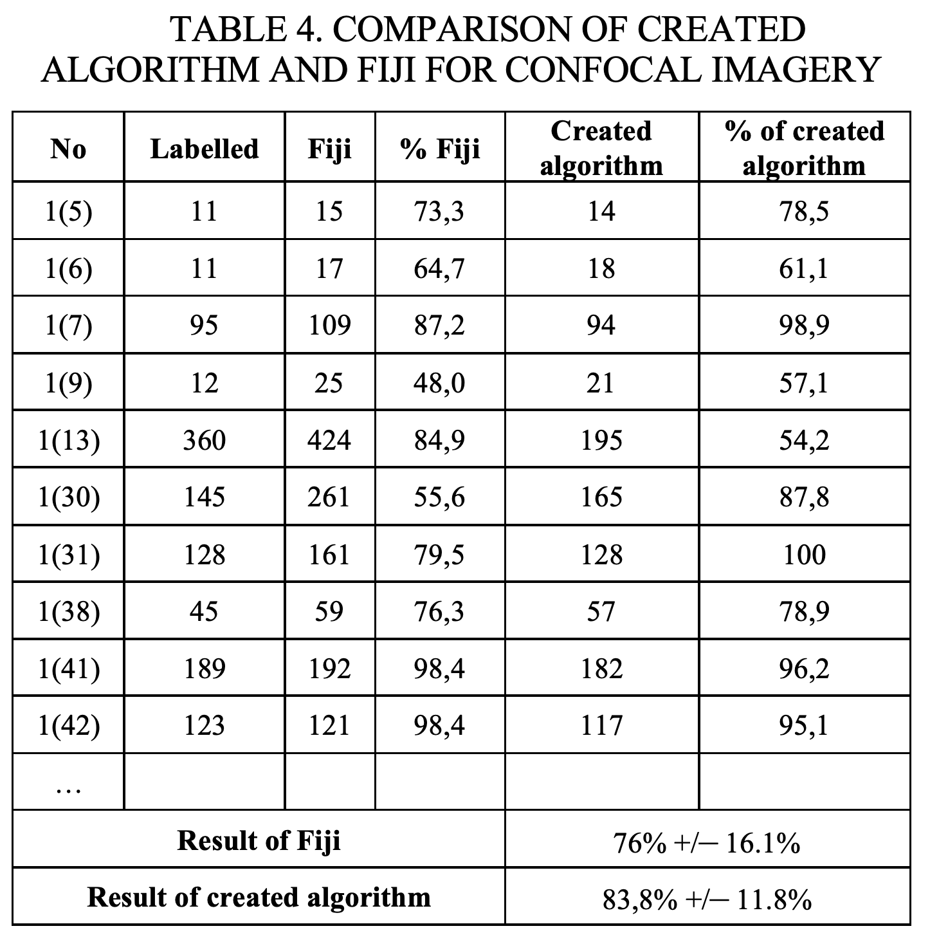
Comparison with Fiji, ImageJ Plugin
Last stage was to compare the obtained data with the results of other applications used to evaluate microphotographs.
Result of Fiji: 76% +/– 16.1%
Result of created algorithm: 83,8% +/– 11.8%
Development of automated computer vision methods for medical images processing

Slide 20
Further research
In the future, it is planned to continue research in this area, improving the reliability of the algorithms, particularly:
Use CNN and U-net networks for better segmentation of core images.
Detect the contours of the scale bar for automatic scaling of the drug.
Automatically recognize marker colors (support more than two colors)
Development of automated computer vision methods for medical images processing

Slide 21
Thank you for your attention!
Authors:
Sergeev D.I. - densvr1@gmail.com
Drobintseva A.O.
Andreev A.E.
Tsenevska S.L.
Links: https://github.com/densvr/biomedicine-diagnostic
The work was done in conjunction with FSBSI “The Research Institute of Obstetrics, Gynecology and Reproductology named after D. O. Ott” of the Ministry of Healthcare of the Russian Federation.

