Slide 1
Technological features of development of the Receipts and Promotions service for the Russian National Payment Card System
Vladislav Belovitskiy
Faculty of Computer Science
HSE University, Moscow

Slide 2
RECEIPTS AND PROMOTIONS: goal, objectives, relevance
GOAL: increasing the efficiency of communication between the Mir payment system, stores and customers
target audience:
- customers – holders of the Mir plastic cards;
- stores – partners of the program
objectives:
- processing information from electronic receipts that are completely identical to printed paper receipts of purchases;
- providing customers with personalized bonus offers from stores;
- assessment of goods and bonus offers by customers
relevance: a unique service that is not implemented in other payment systems; it is potentially able to become a new standard for interaction between the store and the customer

Slide 3
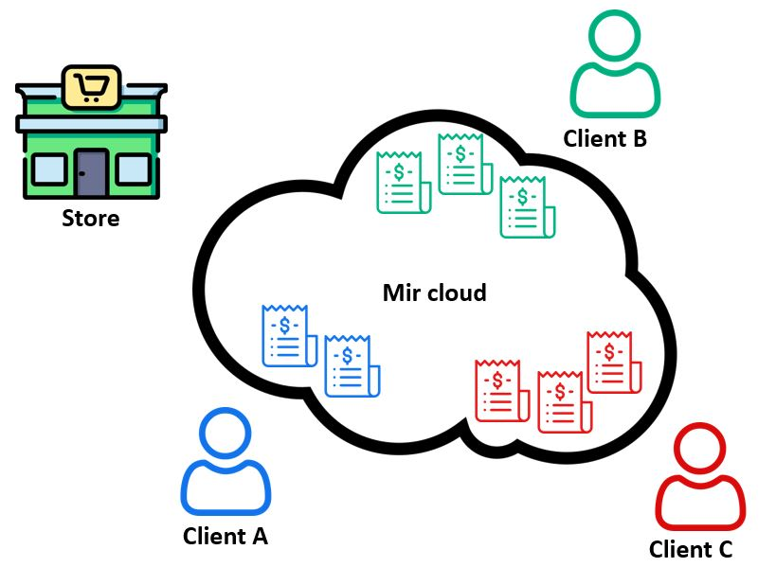
Receipts and Promotions: Participants of communication
• The Mir cloud contains personalized arrays of receipts for each customer.
• It is the main difference from current method of receipts’ storage in the database of fiscal data operator.

Slide 4
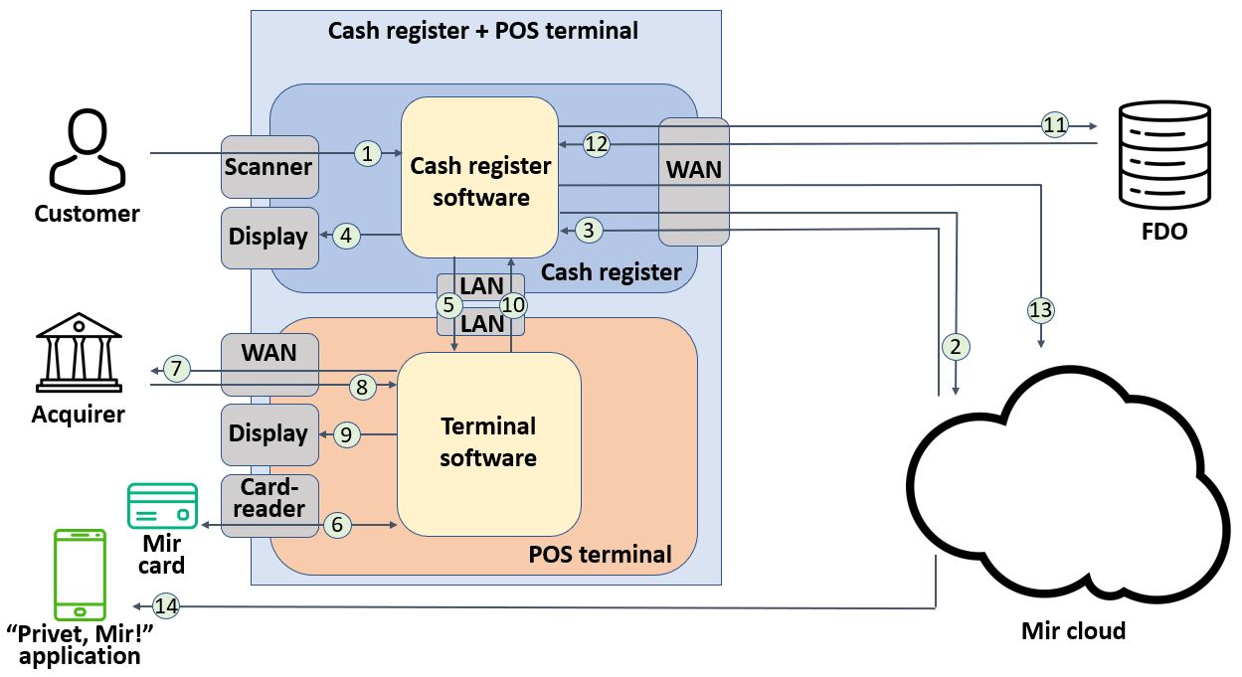
The R&P service architecture : purchase process

Slide 5
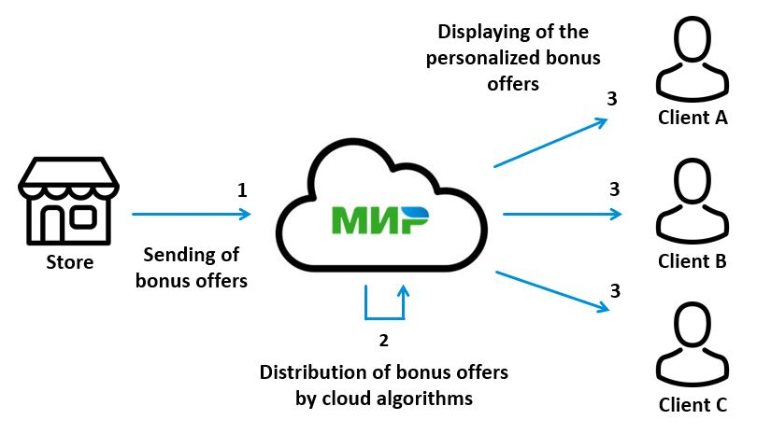
Service architecture: distribution

Slide 6
Why receipt?
Capabilities | Transaction notification (SMS) | Product category report in mobile application | Electronic receipt in the R&P Service
Total purchase sum | + | +– | +
Grouping products by categories | – | + | +
Grouping by certain product | – | – | +
Filtering by type or category of products for a certain period of time | – | +– | +
Export in Excel | – | – | +

Slide 7
Conclusion
• The R&P service is potentially able to become a new standard of interaction between the store and the customer.
• The R&P service through the use of information from electronic receipts will allow stores to effectively distribute bonus offers and make this process convenient for the customer.
• The system of flexible personalization of bonus offers and their assessment by customers is currently not implemented in other software products and is unique.

Slide 8
thank you for your attention!
Vladislav Belovitskiy
Faculty of Computer Science
HSE University, Moscow
vbelovitsky@yandex.ru

